Slide 1

AI and Machine Learning in Finance
Maxime Tchibozo
International FinTech Program
HEC Paris
June 2022

Slide 2
Agenda
Why are Financial Institutions interested in AI / ML?
Overview of core AI concepts
Case Study 1: Trading
Case Study 2: Investment Banking
Frontiers of AI in Finance
Risks for AI Adoption in Finance
Final Thoughts
This is a fully collaborative class.
Please raise your hand, introduce yourselves & tell us about your prior experiences.

Slide 3

Why are Financial Institutions interested in AI/ML?
Financial Institutions are Investing Heavily in AI
Why Now? A Timeline of AI Adoption
Topics in AI

Slide 4


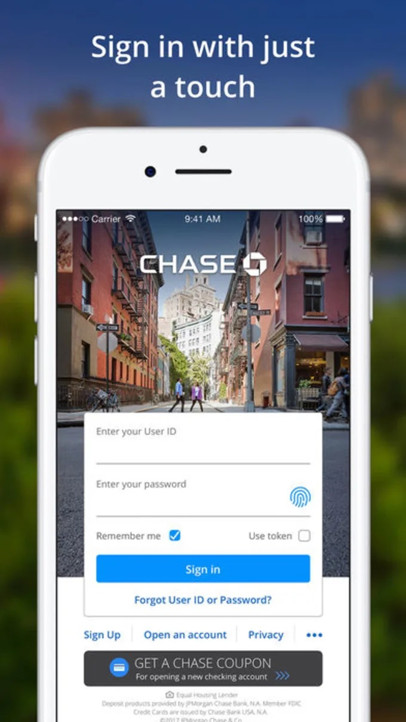




Financial Institutions are Investing Heavily in AI
Investment Banks & Asset Managers
Retail Banks
Insurance Companies
Brokerage Firms
Government Entities

Slide 5
Why Now? How the Current Paradigm of Data Appeared
The AI Paradigm we see today was born from big investments Tech companies made into the Digital world.
90’s Emergence of the Internet
2000s Computer Miniaturization
Tech companies made these investments to pursue the fastest possible growth, valuing scaling above all else.
2010s New Computational Methods
Banks have vastly different priorities. Understanding these differences allows us to find exploitable opportunities.
2020s Cloud Computing Expands AI Reach
Today Banks Seek to Capitalize on AI Opportunities.
How Banks will use AI is question that will get solved over the coming years.
Today, all ideas are welcome.
Important to Keep in Mind: Each of these changes comes with tradeoffs.

Slide 6
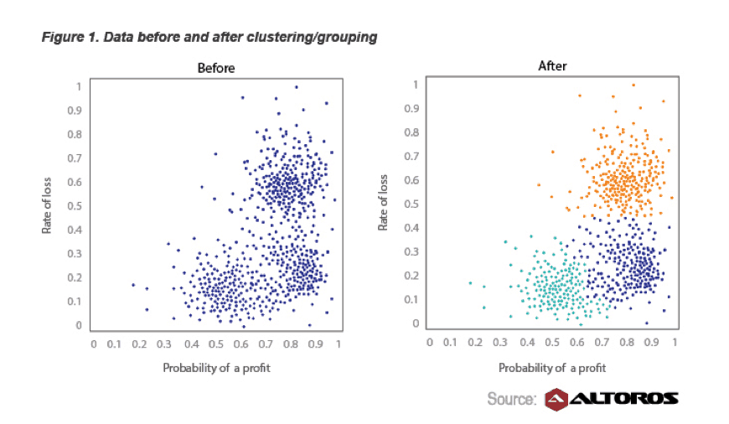
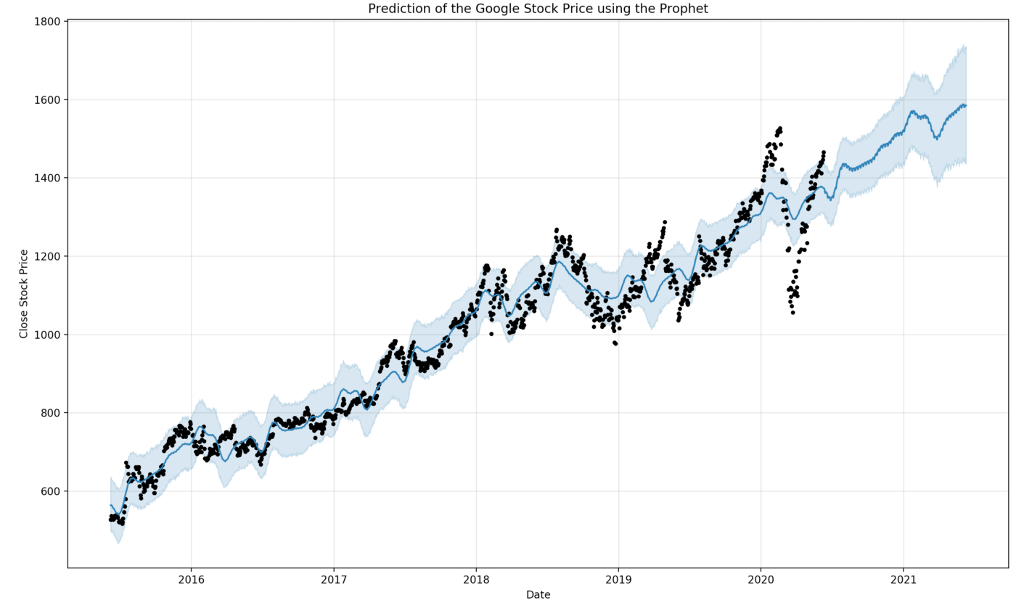
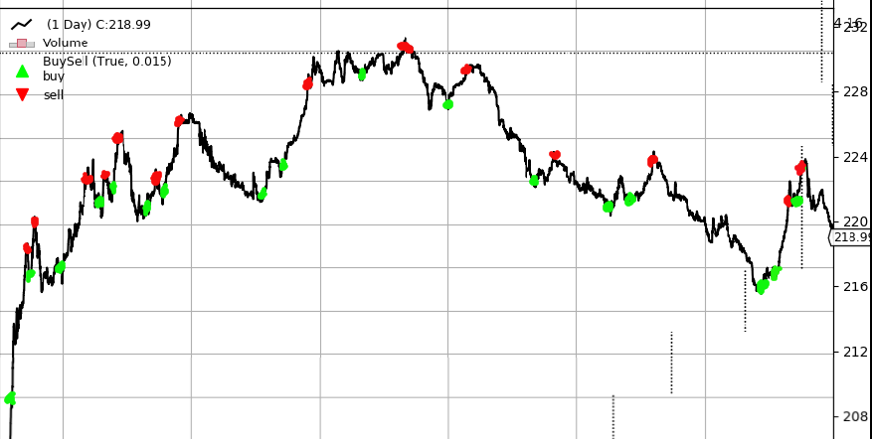
Topics in AI
Unsupervised Learning
Find patterns in data without human guidance
“Here is all the data we have on past trades, can you find an interesting way to group similar trades together”
Supervised Learning
Learn patterns which best replicate a predefined outcome
“This is what the market looked like each time we made a trade up till now. Based on those past trends, can you tell me how the price could evolve after our trade today?”
Reinforcement Learning
Learn to apply optimal policies in a particular environment given specific reward incentives
“Can you tell me in real-time when you think it’s the right moment to buy or sell?”

Slide 7
Topics in AI
Unsupervised Learning
Find patterns in data without human guidance
Clustering & Segmentation
Recommendation Systems
Supervised Learning
Learn patterns which best replicate a predefined outcome
Compression & Representation Learning
Analytics & Visualization
Data Generation & Augmentation
Reinforcement Learning
Learn to apply optimal policies in a particular environment given specific reward incentives

Slide 8
Topics in AI
Unsupervised Learning
Find patterns in data without human guidance
Computer Vision & Natural Language Classification
Object Detection & Entity Recognition
Supervised Learning
Learn patterns which best replicate a predefined outcome
Forecasting & Predictive Modeling
Reinforcement Learning
Learn to apply optimal policies in a particular environment given specific reward incentives

Slide 9
Topics in AI
Unsupervised Learning
Find patterns in data without human guidance
Real-Time Decision Making
Genetic Algorithms
Supervised Learning
Learn patterns which best replicate a predefined outcome
Reinforcement Learning
Learn to apply optimal policies in a particular environment given specific reward incentives

Slide 10
Overview of core AI Concepts
An AI Example: Setting Mortgage Interest Rates
Identifying Main Factors
A Data Science Approach
Data & Representations
Metrics & Evaluation
Model Criticism & Update

Slide 11
An AI Example: Setting Mortgage Interest Rates
How should a Bank set rates for customers looking to buy a home?
A mortgage is a type of loan used to purchase real estate. The borrower agrees to pay the lender - usually a Bank - a series of recurring payments covering the principal amount of the loan and the interest.
The interest is referred to as the mortgage rate.
Which AI topic could this example fit under?
Which factors might affect how a Bank sets mortgage rates?
In France in 2022, the typical mortgage rate range is 1.2% - 2.5%.

Slide 12
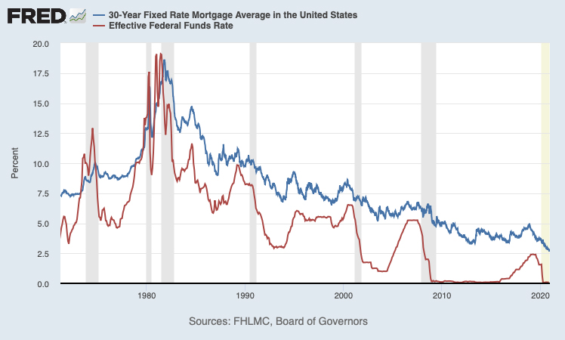
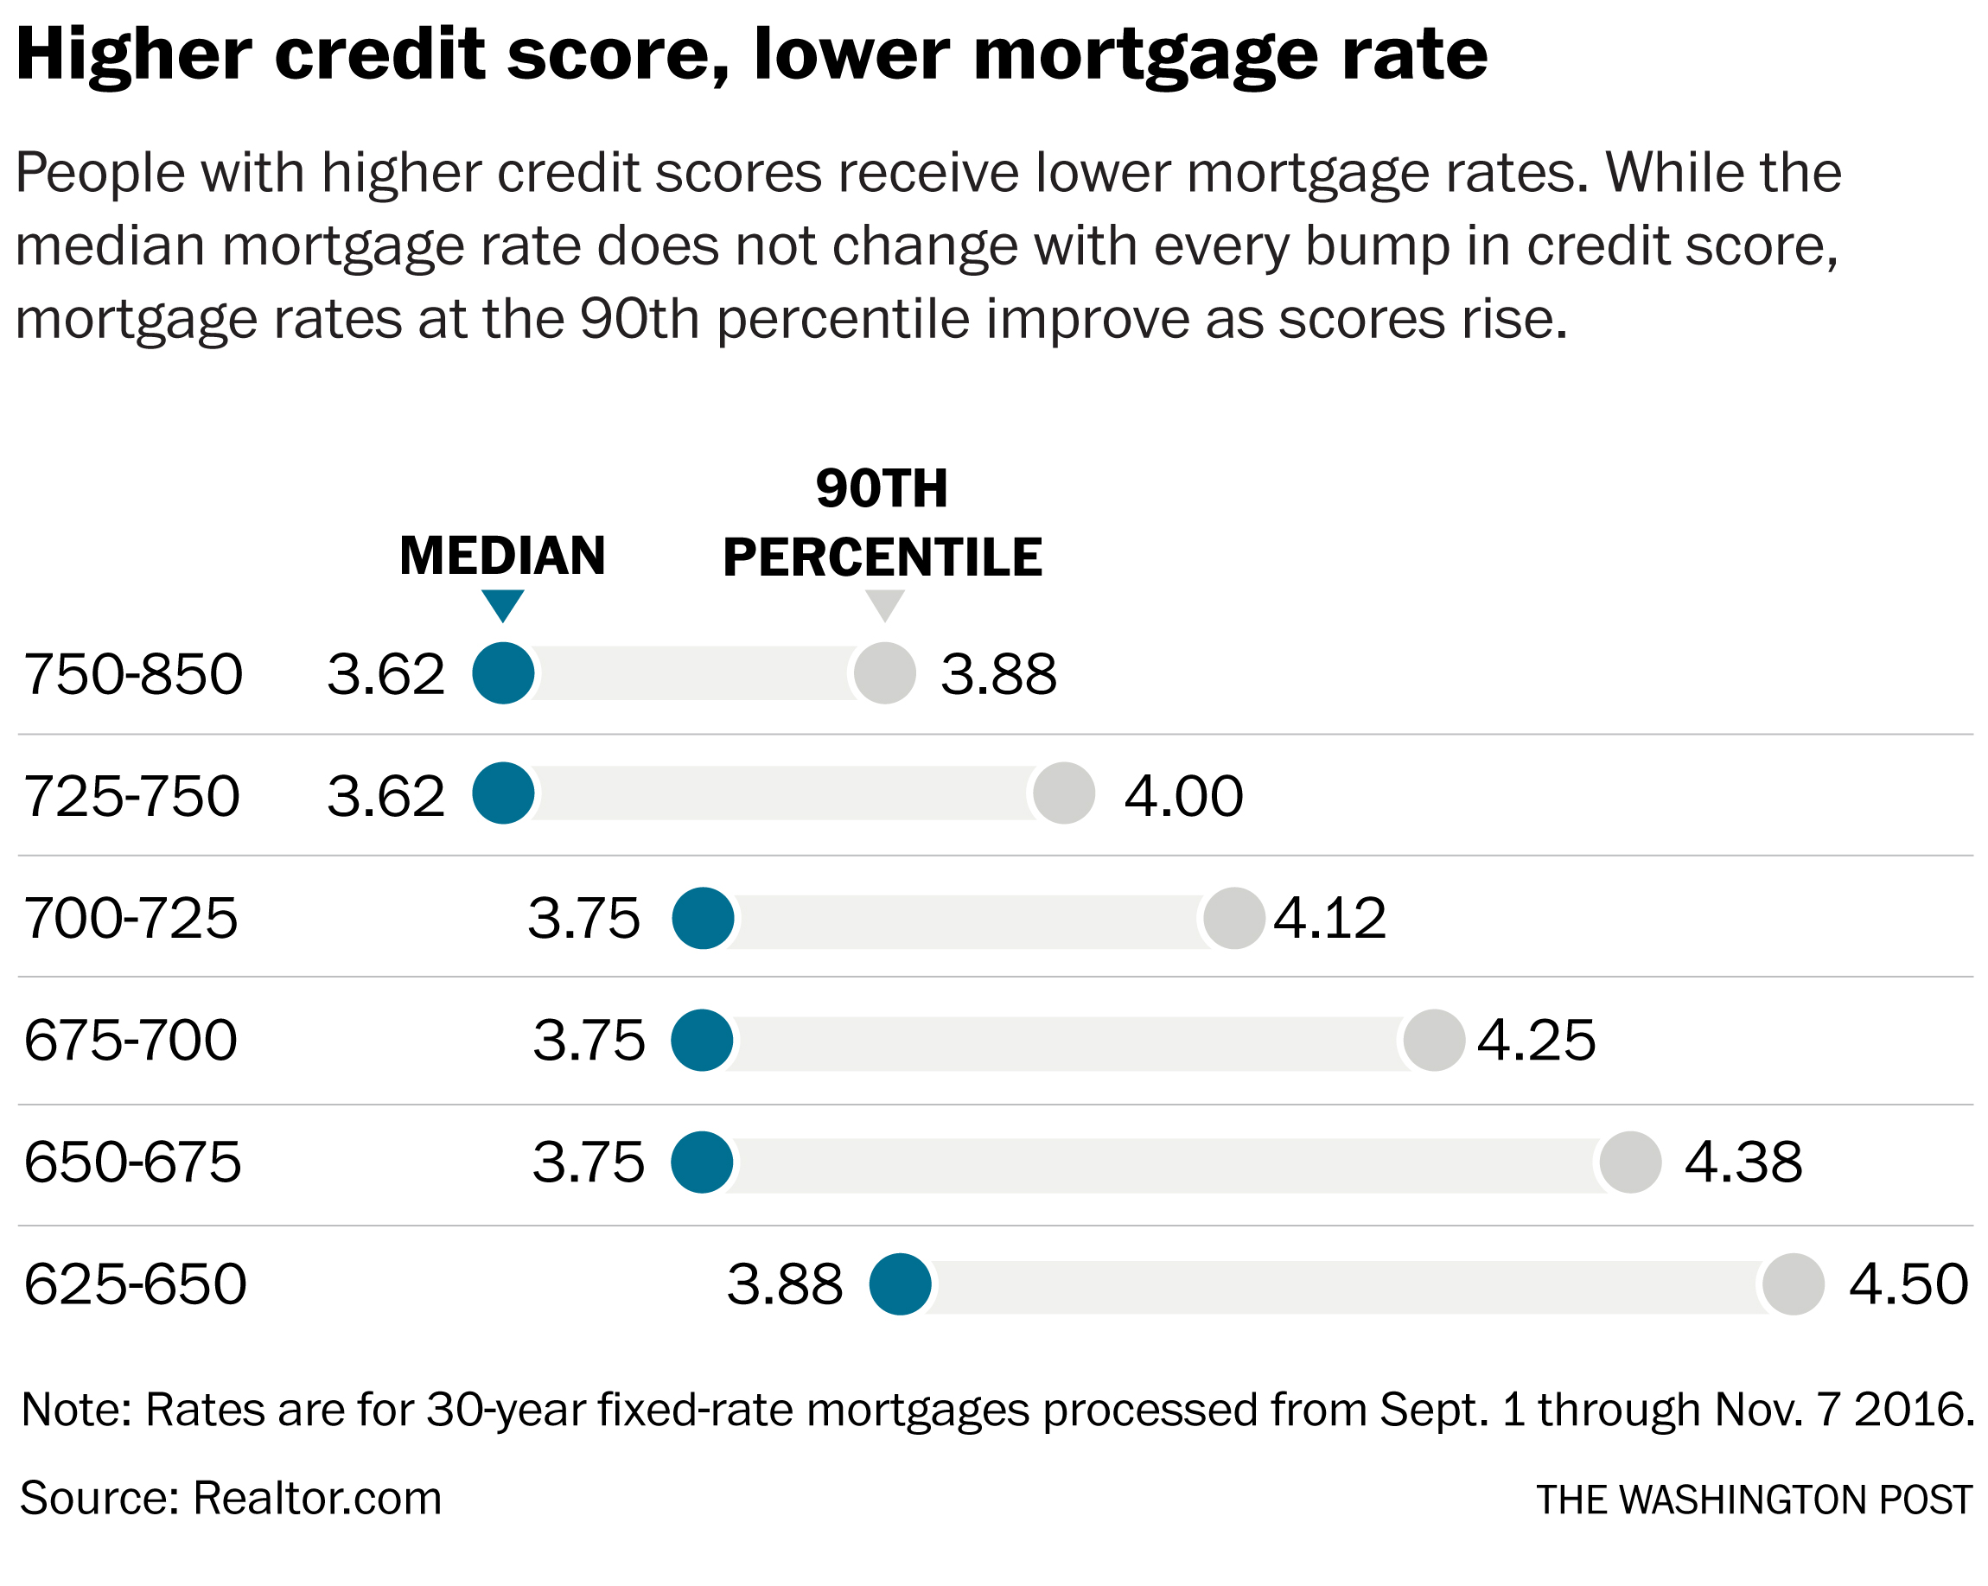
Setting a Mortgage Interest Rate - Main Factors
Personal Factors
Credit score, down payment & collateral, type of property, buyer profile, …
Market Factors
Central Bank interest rates, inflation, competing banks, bonds, …
Product-related Factors
Loan maturity, loan amount, …
Key Considerations
How does each factor affect the Bank’s profit (all else held equal)?
How should each of these factors be weighed?

Slide 13
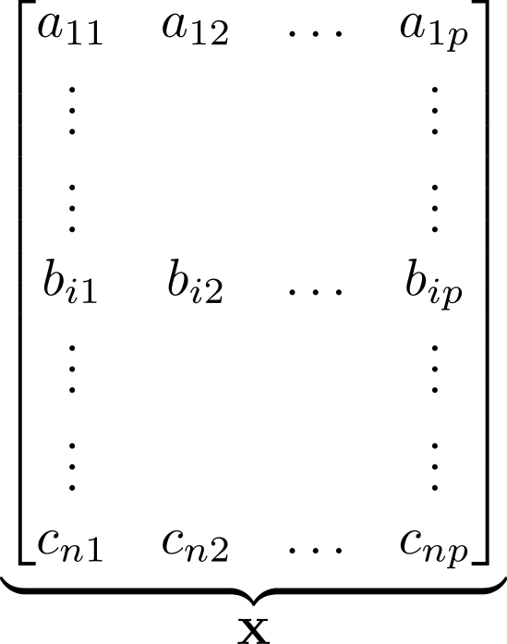

Setting a Mortgage Interest Rate - Data Science Approach
Inputs & Data Types
Representation
Weighing
Output
Market Data
Central Bank interest rates (Spreadsheet)
Inflation figures (Spreadsheet)
Competing Banks (PDF documents)
Personal Data
Credit score (Number)
Down payment (Number)
Collateral (PDF, images)
Type of property (PDF, images, Num.)
Risk profile (PDF)
= 1.8%
Mortgage Interest Rate (Number)
Product Data
Loan maturity (Number)
Loan amount (Number)
Embedding
Parameter Learning
Regression

Slide 14
Setting a Mortgage Interest Rate - Data & Representations
Inputs & Data Types
Representation
All data is preprocessed and converted into a representation (a.k.a embedding).
A good embedding compresses information while preserving the most important properties of the data.
AI algorithms learn patterns from embeddings directly.
Market Data
Central Bank interest rates (Spreadsheet)
Inflation figures (Spreadsheet)
Competing Banks (PDF documents)
Personal Data
Credit score (Number)
Down payment (Number)
Collateral (PDF, images)
Type of property (PDF, images, Num.)
Risk profile (PDF)
Careful consideration is required:
Raw inputs have vastly different formats
Numeric values might be scaled differently
Documents might contain mostly irrelevant information
Data may not cover all the edge cases that appear in reality
Product Data
Loan maturity (Number)
Loan amount (Number)
Embedding

Slide 15
Setting a Mortgage Interest Rate - Metrics & Evaluation
AI models transform embeddings into predictions. Based on how close predictions are to reality, an algorithm will update the weights and the embeddings.
A good AI model can predict correct values even if for inputs / embeddings it has never seen before.
Representation
Weighing
Output
Reality
vs. 1.7%
= 1.8%
Careful consideration is required:
Only unseen data should be used for evaluation
Evaluation should be done multiple times
Data used for evaluation should be representative of data in the real world
The metric used for evaluation must capture underlying properties of the data
AI decisions are not always easily interpretable
Mortgage Interest Rate (Number)
Embedding
Parameter Learning
Regression

Slide 16
Setting a Mortgage Interest Rate - Metrics & Evaluation
Wait! The process is not yet done, even once the model has finished predicting. We criticize the model to identify further improvements.
Weighing
Output
Reality
Typical model criticism questions:
Do these predictions make common sense?
Was all the data used informative?
Were any important factors missed?
Do the learnt representations capture properties of underlying data?
Is the sample size large enough?
Is the algorithm explainable?
Is there a tradeoff between prediction performance and explainability of decisions?
vs. 1.7%
= 1.8%
Mortgage Interest Rate (Number)
Parameter Learning
Regression

Slide 17
Case Study #1: Trading
Trade Execution
Trade Validation
Know Your Customer

Slide 18
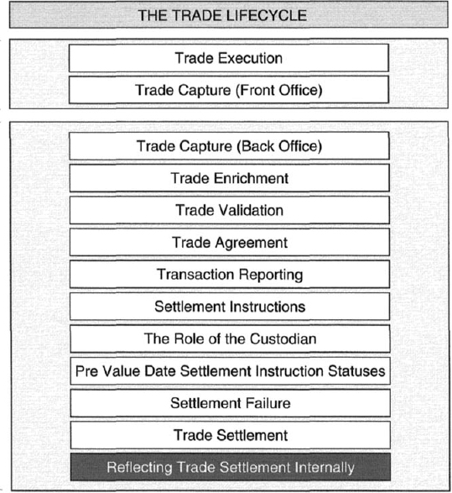
Trading Case Study: Lifecycle of a Trade
A trader initiates a trade with the purchase or sale of an asset, commodity, option. The buyer and seller enter into an agreement, with a set price, volume, etc.
Operational teams then specify the logistics of the trade between parties.
We compare traditional and AI-driven approaches to the trading lifecycle.
Key Questions to Keep in Mind
Where are the bottlenecks in the traditional process?
What is stopping the Bank from scaling its action?
Which parts of the traditional process would benefit from being data-driven?

Slide 19
Trading Case Study: Lifecycle of a Trade - Trade Execution
The trader is a human expert in anticipating price or volatility fluctuations for a given market. They have experience, know the market and get pricing assistance from quants. They use their knowledge and intuition to time the trade and get the best possible price.
Where are the bottlenecks in the traditional process?
What is stopping the Bank from scaling its action?
Which parts of the traditional process would benefit from being data-driven?

Slide 20
Trading Case Study: Lifecycle of a Trade - Trade Execution
The trader is a human expert in anticipating price or volatility fluctuations for a given market. They have experience, know the market and get pricing assistance from quants. They use their knowledge and intuition to time the trade and get the best possible price.
Bottlenecks (non-exhaustive)
Attention, Speed, Risk Limits, Latency, Emotion, …
How can AI help?
News Aggregation Methods: Real-time Big Data summarization of the web (Bloomberg, Twitter, Reddit, Government Data).
Machine Learning-Based Pricing: Combine Quant probabilistic pricing methods with Machine Learning-based estimators.
Identifying Trading Opportunities: Automatically compare market patterns to historically similar trading charts.
Where are the bottlenecks in the traditional process?
What is stopping the Bank from scaling its action?
Which parts of the traditional process would benefit from being data-driven?

Slide 21
Trading Case Study: Lifecycle of a Trade - Trade Validation
Operational teams reconcile information from the trade with the counterpart. Buyer and seller send each other documentation with the agreed upon details.
Ops. teams verify that both parties have the exact same information. In some cases, they have two days to validate the details and disclose the trade to government entities.
Where are the bottlenecks in the traditional process?
What is stopping the Bank from scaling its action?
Which parts of the traditional process would benefit from being data-driven?

Slide 22
Trading Case Study: Lifecycle of a Trade - Trade Validation
Operational teams reconcile information from the trade with the counterpart. Buyer and seller send each other documentation with the agreed upon details.
Ops. teams verify that both parties have the exact same information. In some cases, they have two days to validate the details and disclose the trade to government entities.
Bottlenecks (non-exhaustive)
Time, Complexity, Documentation Errors, …
How can AI help?
Automated Trade Detail Extraction: Document Understanding algorithms extract prices, amounts, and dates from PDF & images.
Document Management: Classification algorithms automatically categorize document types (invoice, contract, bill of lading, …).
Anomaly Detection: Algorithms can automatically flag documents with missing or incorrect information.
Where are the bottlenecks in the traditional process?
What is stopping the Bank from scaling its action?
Which parts of the traditional process would benefit from being data-driven?

Slide 23
Trading Case Study: Lifecycle of a Trade - Know Your Customer
Every trade transiting through a Bank is screened. Brokers found guilty of approving transactions involving sanctioned entities can be fined. Banks must collect identifiable details such as personal information. These identifiers are crossed with public watchlists and flagged if they involve sanctioned individuals.
This is a key topic in crypto.
Where are the bottlenecks in the traditional process?
What is stopping the Bank from scaling its action?
Which parts of the traditional process would benefit from being data-driven?

Slide 24
Trading Case Study: Lifecycle of a Trade - Know Your Customer
Every trade transiting through a Bank is screened. Brokers found guilty of approving transactions involving sanctioned entities can be fined. Banks must collect identifiable details such as personal information. These identifiers are crossed with public watchlists and flagged if they involve sanctioned individuals.
This is a key topic in crypto.
Bottlenecks (non-exhaustive)
Data Complexity, Volume, Public Data, Regulatory Changes
How can AI help?
Entity Recognition: Matching algorithms can disambiguate companies and persons appearing under multiple names.
Public Watchlist Monitoring: Automatic aggregation of data from public sources can help quickly adapt to geopolitical events.
Anomaly Detection: Algorithms reduce operational workload by automatically reviewing and labelling transactions flagged by algorithms.
Where are the bottlenecks in the traditional process?
What is stopping the Bank from scaling its action?
Which parts of the traditional process would benefit from being data-driven?

Slide 25
Case Study #2: Investment Banking
Client Onboarding
Due Diligence
Portfolio / Loan Management

Slide 26
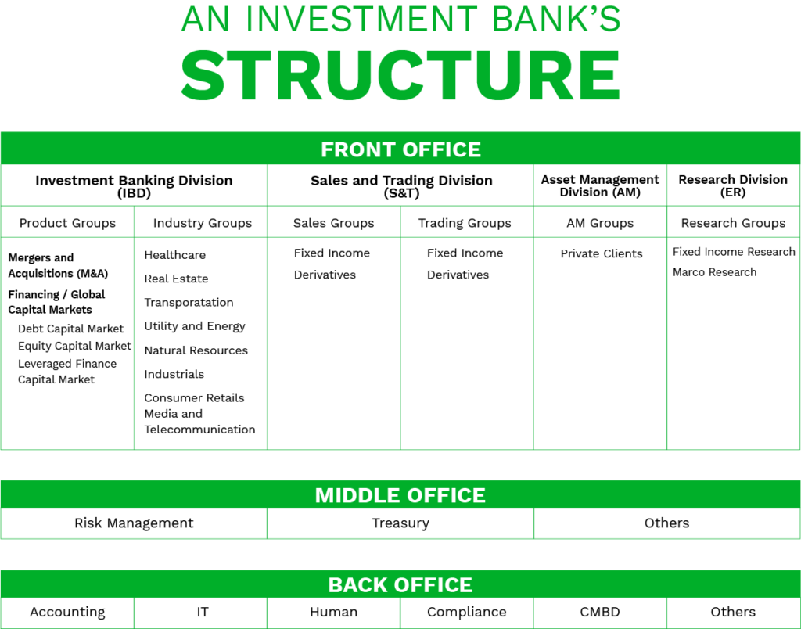
Investment Banking Case Study: Banking Lifecycle
Corporate and Investment Banks are banks for companies.
Companies raise money to grow, either organically or through acquisitions. Banks provide companies with debt, assist them in raising equity, or advise on potential deals.
We compare traditional and AI-driven approaches to the banking lifecycle.
Key Questions to Keep in Mind
Where are the bottlenecks in the traditional process?
What is stopping the Bank from scaling its action?
Which parts of the traditional process would benefit from being data-driven?

Slide 27
Investment Banking Case Study: Client Onboarding
The investment banker works on behalf of a company looking to sell part or all of its business. They cover companies in a specific sector and are experts in matching companies from this sector with buyers. In the deal preparation phase, the banker estimates a value for the deal, notifies potential buyers, and keeps only the best matches.
Where are the bottlenecks in the traditional process?
What is stopping the Bank from scaling its action?
Which parts of the traditional process would benefit from being data-driven?

Slide 28
Investment Banking Case Study: Client Onboarding
The investment banker works on behalf of a company looking to sell part or all of its business. They cover companies in a specific sector and are experts in matching companies from this sector with buyers. In the deal preparation phase, the banker estimates a value for the deal, notifies potential buyers, and keeps only the best matches.
Bottlenecks (non-exhaustive)
Speed, High Demand, Market Appetite, Marketing, …
How can AI help?
Recommendation Systems: Given historical data of deals involving similar buyers and sellers, what is the likelihood of this deal going through?
News Aggregation & Sentiment Analysis: Which companies are likely to have an appetite for deals based on information they shared publicly?
Anomaly Detection: Which potential buyers can be instantly rejected based on informative metrics?
Where are the bottlenecks in the traditional process?
What is stopping the Bank from scaling its action?
Which parts of the traditional process would benefit from being data-driven?

Slide 29
Investment Banking Case Study: Due Diligence
Once the banker has identified a suitable buyer, they grant them exclusive access to the client’s financial and operational information. All relevant information is quickly and thoroughly checked to minimize deal uncertainty. The banker and buyer draft a legal contract for the purchase and agree on a deal valuation.
Where are the bottlenecks in the traditional process?
What is stopping the Bank from scaling its action?
Which parts of the traditional process would benefit from being data-driven?

Slide 30
Investment Banking Case Study: Due Diligence
Once the banker has identified a suitable buyer, they grant them exclusive access to the client’s financial and operational information. All relevant information is quickly and thoroughly checked to minimize deal uncertainty. The banker and buyer draft a legal contract for the purchase and agree on a deal valuation.
Bottlenecks (non-exhaustive)
Discretion, Modeling Issues, Data Quality, Market Risk, …
How can AI help?
Contract Understanding: Algorithms can scan contracts to avoid clauses which shift the balance of the deal.
Compliance & Anomaly Detection: Client information may contain accounting issues which affect the deal price.
Pricing: Machine Learning can help generate realistic scenarios to stress-test financial models.
Where are the bottlenecks in the traditional process?
What is stopping the Bank from scaling its action?
Which parts of the traditional process would benefit from being data-driven?

Slide 31
Investment Banking Case Study: Portfolio / Loan Management
Aside from M&A, banks lend money to corporate clients to help them execute their strategy. Loan monitoring teams keep track of all the loans the Bank makes and fees it receives. Multiple banks can participate in a loan, in which case they receive information on all the other banks’ participation.
Where are the bottlenecks in the traditional process?
What is stopping the Bank from scaling its action?
Which parts of the traditional process would benefit from being data-driven?

Slide 32
Investment Banking Case Study: Portfolio / Loan Management
Aside from M&A, banks lend money to corporate clients to help them execute their strategy. Loan monitoring teams keep track of all the loans the Bank makes and fees it receives. Multiple banks can participate in a loan, in which case they receive information on all the other banks’ participation.
Bottlenecks (non-exhaustive)
Data Quality, Competition, Yield, Attention, …
How can AI help?
Document Understanding: Loans involving many banks generate large amounts of documentation.
Market Intelligence: Valuable intel on competing banks can be extracted from information companies disclose.
Analytics: Automatically identify low-fee / low-yield loans to reallocate capital to more profitable clients.
Where are the bottlenecks in the traditional process?
What is stopping the Bank from scaling its action?
Which parts of the traditional process would benefit from being data-driven?

Slide 33
Frontiers of AI in Finance
LegalTech & Contract Understanding
Document Management & Search Engines
Causality & Interpretable Machine Learning

Slide 34
LegalTech & Contract Understanding
Agreements between buyers and sellers are made legally binding with contracts.
In Banking, large deals or large loans come with equally long contracts.
In Trading, contracts related to complex products (options, swaps, derivatives) cause many headaches for Trade Validation and Risk teams.
The contract is perhaps the most important document, but can hide unfair clauses. If a bad deal is signed, it can become valid!
Example Financial use-cases
Does this contract allow me to sell my participation in this loan?
What does this company mean by “Entry into a Material Agreement”?
Clause extraction software can identify provisions in contracts and summarize them into simple English

Slide 35
Document Management & Search Engines
Advances in Natural Language Processing make it possible to directly query documents using free text. Combined with a recommendation system, this can effectively create a search engine across all files in a database. This could allow users to query information from files without having to open and read the files manually.
Example Financial use-cases
Which files in the database mention our 2018 credit agreement with L’Oréal?
Did this company share any information on competing banks in their quarterly reports?
What differences exist between these two versions of the same file?

Slide 36
Causality & Interpretable Machine Learning
Causal Inference is a framework used in Statistics to quantify the effect variables have on outcomes. Given the importance of audits in Finance, causality could help bridge the gap between opaque AI models and explainable financial models. Causal Inference plays a large role in Economics, but is challenging to implement in practice and requires extreme care to avoid misinterpreting results.
Economists use Causal Inference…
…to evaluate the effect of policies on labor markets.
Example Financial use-cases
What is the effect of a stock-split on the stock’s price?
Why was this transaction flagged as fraudulent?
What is the effect of a mortgage rate increase on defaults?
Pharmaceutical companies use Causal Inference…
…to measure the effect of a treatment (vaccine, antibiotic, etc.) on a patient’s medical condition.
Social media companies use Causal Inference…
…to measure the effect of a UI change on user behavior.

Slide 37
Risks for AI Adoption in Finance

Slide 38
Risks From AI in Finance
Cybersecurity
Infrastructure
Audit & Explainability
Model Errors
Data Privacy

Slide 39
Final Thoughts
Many AI in Finance topics we didn’t cover (Asset Management, Pricing, Insurance, Retail Banking, Research, etc.)
All feedback welcome (positive and negative)
Slides available at github.com/mtchibozo/hec-international-fintech
Many of these challenges will be up to you to solve, start coding!
Thank You!

